Slide 1

Relational Database Management System
réalisée par Amira Sayari

Slide 2
RDBMS
RDBMS or Relational database management system is a subset for DBMS or database management system designed specifically for relational database.
Most well known DBMS applications fall into the RDBMS category. Examples include MySQL, PostgresSQL and SQL server.

Slide 3
My Sql
My SQL is a server database
My SQL stores data in separate tables rather than putting everything together in a single table.
It is compatible with almost all platforms including Linux , Unix and Windows.
Used for all kinds of applications, it is most often associated with web applications and online content publishing.

Slide 4
My SQL Fonctionalities:
Completely multi-threaded, thanks to the kernel threads. This means that you can use it easily on a server with multiple processors.
SQL functions are implemented thanks to a library of optimized classes, which are as fast as possible! Usually, there is no memory allocation after the query has been initialized.
Many types of columns: signed integers or not, of 1, 2, 3, 4, and 8 bytes, FLOAT, DOUBLE, CHAR, VARCHAR, TEXT, BLOB, DATE, TIME, DATETIME...
A very flexible and secure system of rights and passwords, which also verifies the connecting hosts. Passwords are well protected, because all password exchanges are encrypted, even during connections.
All data is saved in the chosen character set. Normal string comparisons are case insensitive.

Slide 5
Postgre sql
PostgreSQL is a powerful, open source object-relational database system with over 30 years of active development that has earned it a strong reputation for reliability, feature robustness, and performance.
PostgreSQL is not controlled by a single company, but is founded on a global community of developers and companies.

Slide 6
PostgreSql features:
ThisRDBMS uses modern data types, known as composed or enriched according to the terminologies used in the usual computer term. This means that PostgreSQL can store more data types than the traditional simple types integers, characters, etc. User can create types, functions, use type inheritance, etc.
It works on various hardwareplatforms and under different operating systems.
PostgreSQL is widely recognized for its stable behavior, extended programming possibilities, directly in the database engine, via PL/pgSQL.
Internal data processing can also be coupled with other external modules compiled in other languages

Slide 7
SQL server
SQL Server is a database management system (DBMS) developed and marketed by Microsoft .
Microsoft SQL Server is now part of Microsoft's technical database strategy. The MSDE engine, which is the basis of SQL Server, should eventually replace the Jet engine (the one that manages the Access databases ) in applications such as Exchange and Active Directory .

Slide 8
SQL Server features:
Intelligence across all your data with Big Data Clusters. Break down data silos. …
Choice of language and platform. Run SQL Server anywhere. ..
Most secured data platform. Fewest vulnerabilities for nine years.
Unparalleled high availability
End-to-end mobile BI

Slide 9
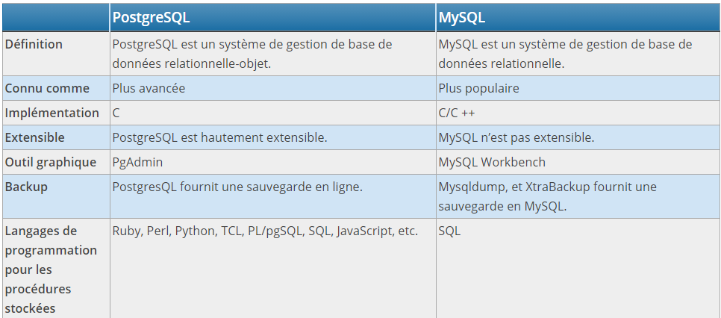
Comparison:

